Slide 1
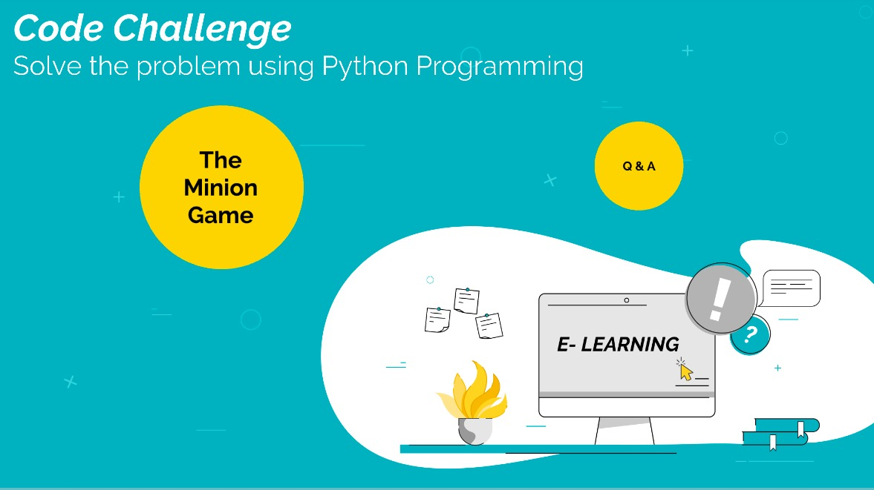
Code Challenge: THE MINION GAME
Solve using Python Script

Slide 2
Kevin and Stuart want to play the 'The Minion Game'.
Game Rules
Both players are given the same string, S .
Both players have to make substrings using the letters of the string S.
Stuart has to make words starting with consonants.
Kevin has to make words starting with vowels.
The game ends when both players have made all possible substrings.

Slide 3
CONTD.
Scoring A player gets +1 point for each occurrence of the substring in the string
For Example: String S = BANANA Kevin's vowel beginning word = ANA Here, ANA occurs twice in BANANA. Hence, Kevin will get 2 Points.
Your task is to determine the winner of the game and their score.

Slide 4
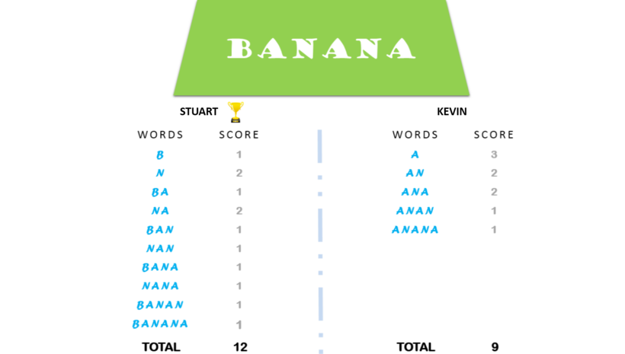

Slide 5
Output Format Print One Line: The Name Of The Winner And Their Score Separated By A Space. If The Game Is A Draw, Print Draw.
Sample Input
BANANA
Sample Output
Stuart 12

Slide 6
Guess who wins??
Sample Input
FLOCCINAUCINIHILIPILIFICATION
Output
Stuart ??
Kevin ??

Slide 7
CODE
def minion_game(s):
s1=0
s2=0
vow='AEIOU’
for i in range(len(s)):
if s[i] not in vow:
s1=s1+len(s[i:])
else:
s2=s2+len(s[i:])
if s1>s2:
print("Stuart", s1)
elif s2>s1:
print("Kevin", s2)
else:
print("Draw")
if __name__ == '__main__':
s = input()
minion_game(s)

